Slide 1
Outline Of Today’s Discussion
Review of Wave Properties, and Fourier Analysis
The Contrast Sensitivity Function
Metamers
Selective Adaptation And The Size Aftereffect

Slide 2
Part 1
Review of Wave Properties
And
Fourier Analysis

Slide 3
Part 1: Waves & Fourier Analysis
The cycles of waves can be described by four features, or “parameters”.
These are Frequency, Amplitude, Phase, and Orientation.
A helpful acronym is F.A.P.O..
Let’s see examples of how each parameter…

Slide 4
These Differ In Frequency
Low Spatial Frequency
Fat Bars:
Few Cycles Per Degree
C.P.D.
High Spatial Frequency
Thin Bars:
Many Cycles Per Degree
C.P.D.

Slide 5
These Differ In Amplitude (or Contrast)
Low Amplitude
(Low Contrast)
High Amplitude
(High Contrast)

Slide 6
These Differ In Phase (Relative Position)
Zero Phase
(“Start With Black”)
180 Degree Phase Shift
(“Start With White”)

Slide 7
These Differ In Orientation
Vertical Orientation
Horizontal Orientation

Slide 8
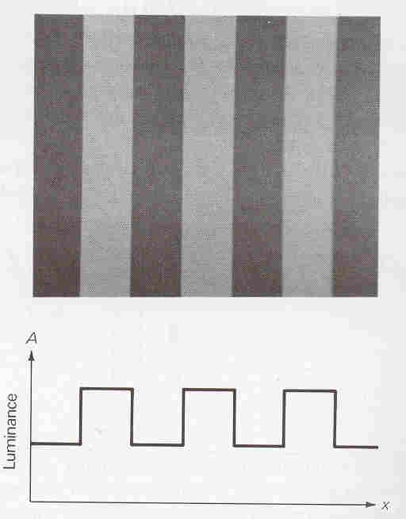
Part 1: Waves & Fourier Analysis
This is a
Square Wave Grating:
The Luminance Changes
Abruptly.

Slide 9
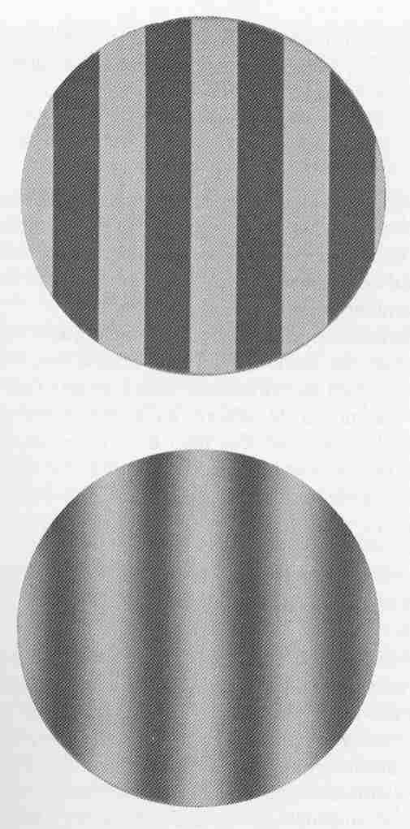
Part 1: Waves & Fourier Analysis
Square Wave Grating
Changes Abruptly
Sine Wave Grating
Changes Slowly

Slide 10
Part 1: Waves & Fourier Analysis
Square Wave Grating
Changes Abruptly
Sine Wave Grating
Changes Slowly
This is Sinusoidally
Modulated in Luminance.

Slide 11
Sine Wave in Luminance
100
Luminance
0
Left
Right
Space

Slide 12
Sine Wave in Wave Lengths
700
Red
Wave Length (nm)
Yellow
Green
510
Left
Right
Space

Slide 13
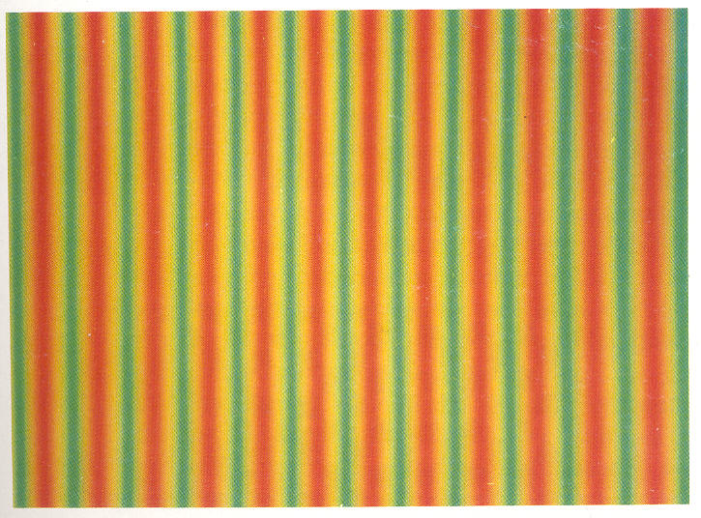
A Red-Green Grating:
Sinusoidally Modulated Wavelengths

Slide 14
Part 1: Waves & Fourier Analysis
Now, Back To Luminance Profiles…
Space Domain First,
Then The Frequency Domain.

Slide 15
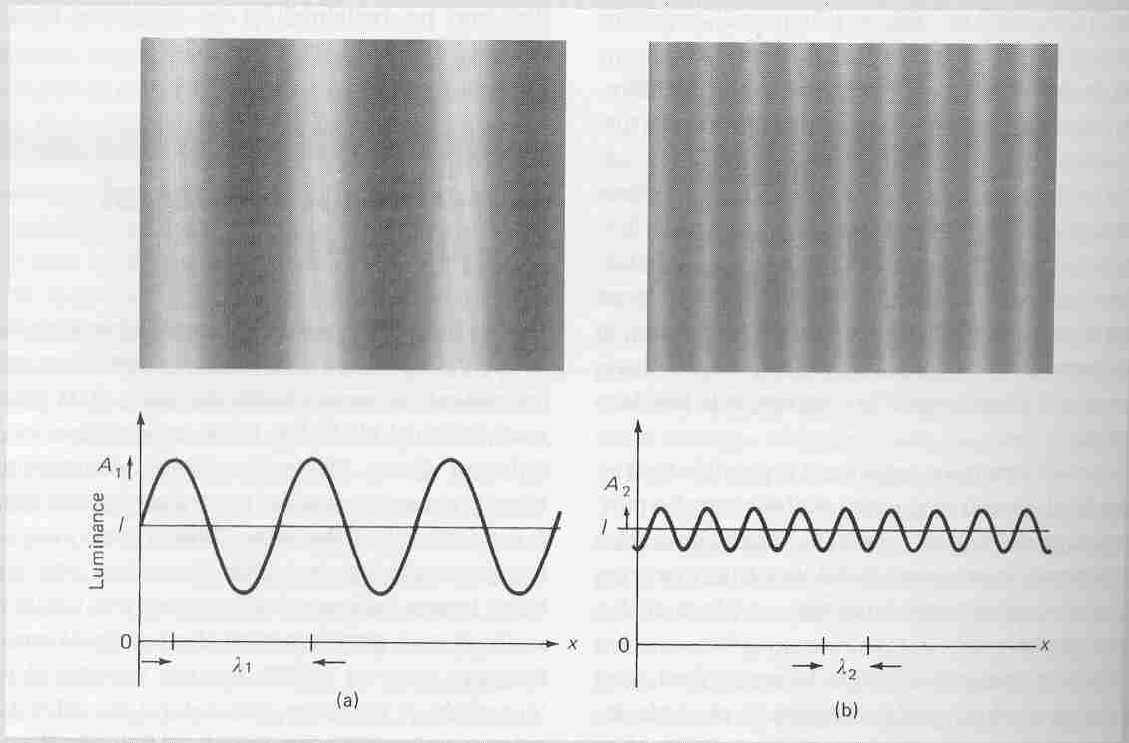
This is the profile in the “Space Domain”
Space is on the X-Axis.

Slide 16
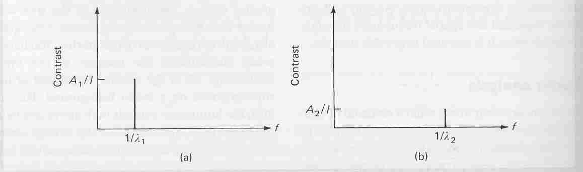
Bottom: profile in the “Frequency Domain”
Frequency is on the X-Axis

Slide 17
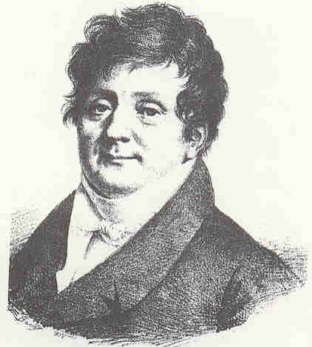
Joseph (Jean Baptiste) Fourier

Slide 18
Part 1: Waves & Fourier Analysis
According to Fourier, we should be able to
construct a square wave stimulus
(or any other stimulus),
by combining sine waves of the correct
F.A.P.O..

Slide 19
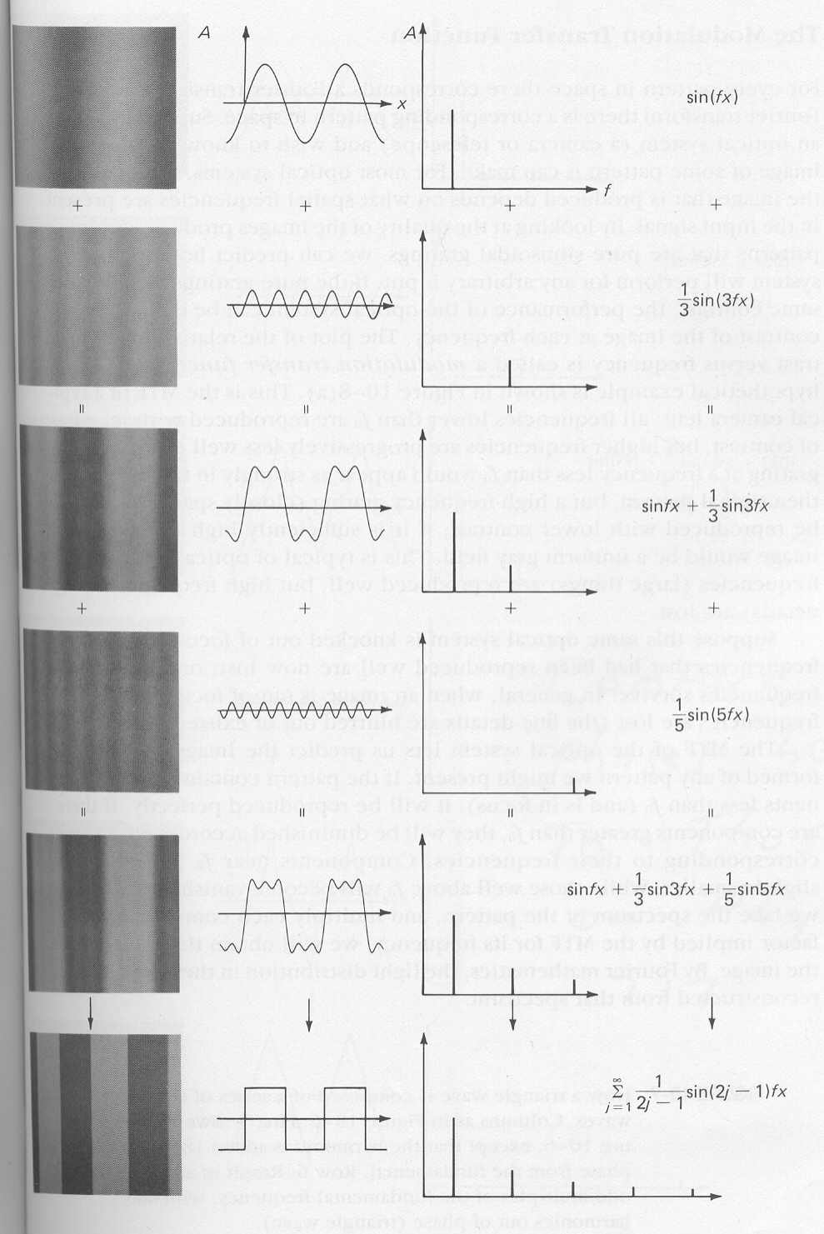
These
Added
Together
Make This

Slide 20
These
Added
Together
Make This

Slide 21
Eventually,
You’ll
Make This

Slide 22
Part 1: Waves & Fourier Analysis
A square wave can be built from component
sine waves, if the sine waves all have the same phase.
What happens if you introduce a phase shift
(say 180 degrees or a half cycle)?

Slide 23
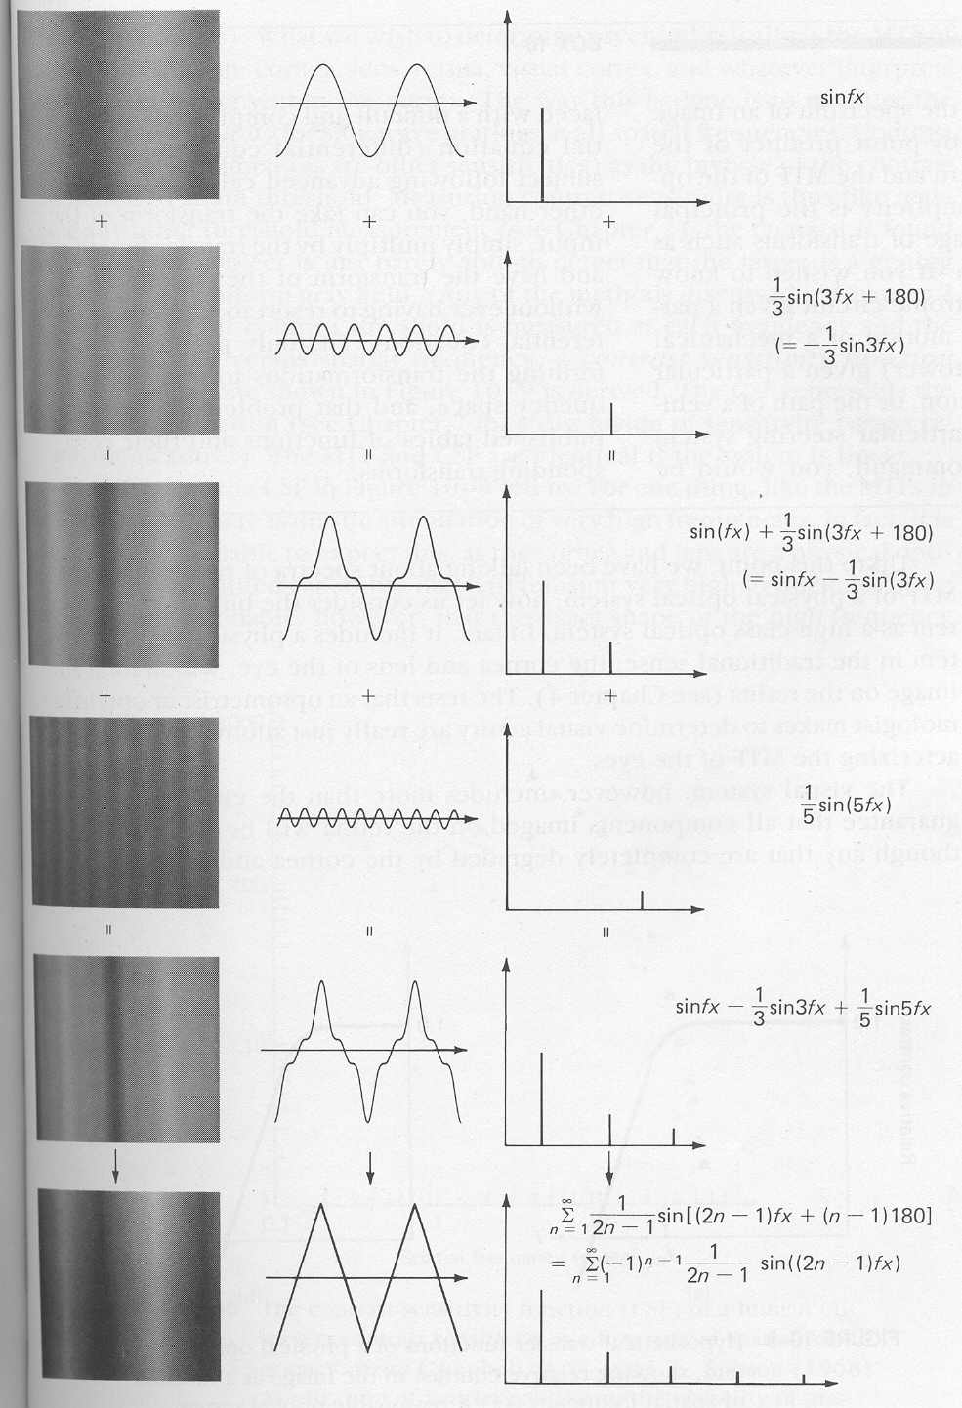
These
Added
Together
Make This

Slide 24
These
Added
Together
Make This

Slide 25
Eventually,
You’ll
Make This

Slide 26
Part 1: Waves & Fourier Analysis
Let’s take a very close look at
the square wave and triangle wave,
side-by-side….

Slide 27
The phase
difference
should be
180 deg,
but the
schematic
shows a
90 deg
difference
(quarter
cycle rather
than a half
cycle).
Sorry about
That.
Note the slight
differences in
starting phase
(in red circles)
Square
Wave
Triangle
Wave

Slide 28
Part 1: Waves & Fourier Analysis
By shifting the components 180 degrees,
a different image is produced, namely,
a triangle wave (not a square wave).
So, Phase Matters!

Slide 29
Part 1: Waves & Fourier Analysis
Different spatial frequencies specify how light is distributed at various spatial scales.
Low spatial frequencies specify the most global spatial scales (i.e., ground versus sky). “Low pass” images appear blury, and lack fine detail.
High spatial frequencies specify the finest spatial scales. “High pass” images appear as outlines, showing the boarders between objects.
Intermediate spatial frequencies specify information at scales between the two extremes.

Slide 30
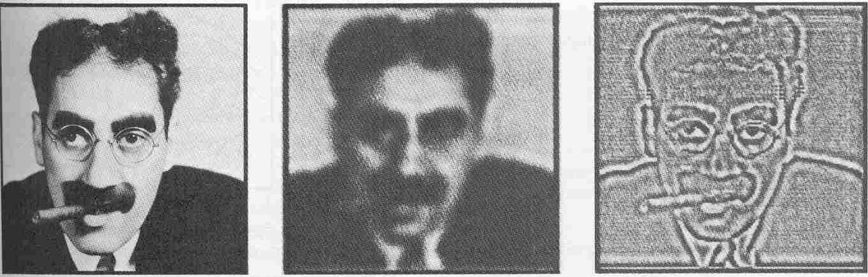
Part 1: Waves & Fourier Analysis

Slide 31
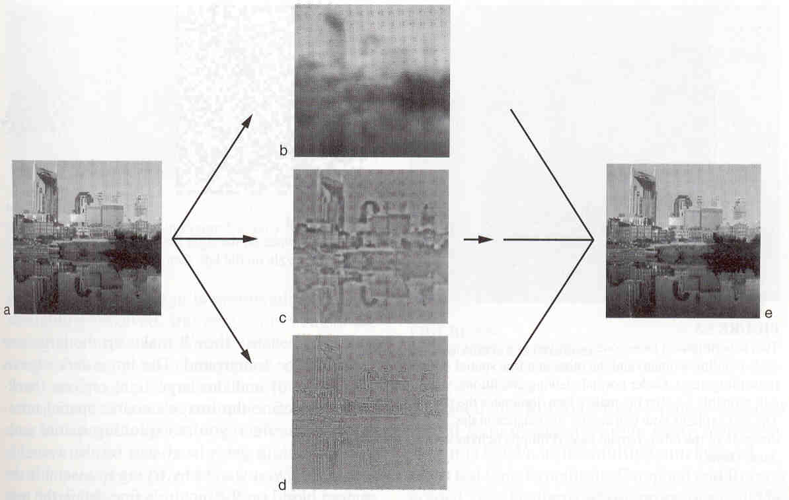
Some More Examples
Potential Pop Quiz Question: In your own words
Explain what is happening in the diagram below.

Slide 32
Part 1: Waves & Fourier Analysis
It is a FACT that any image can be
decomposed into its “Fourier Components”
But is it true that our visual systems
conduct a Fourier Analysis on the retinal image?

Slide 33
Here’s The RF Of A Visual Neuron
-
-
-
-
+
-
+
+
-
+
+
+
+
+
-
+
+
-
-
-
-
-
-
-

Slide 34
RFs Vary In Size,
And Size Corresponds To
Spatial Frequency.
-
-
-
-
-
-
-
+
-
-
-
-
+
+
+
+
-
-
-
-
+
+
+
+
+
+
-
-
+
+
+
-
+
-
+
+
+
+
+
+
-
+
+
+
-
+
+
+
+
+
-
-
+
-
-
-
-
-
-
-
-
-
-
-
-
-
-
-
-
-
-
-

Slide 35
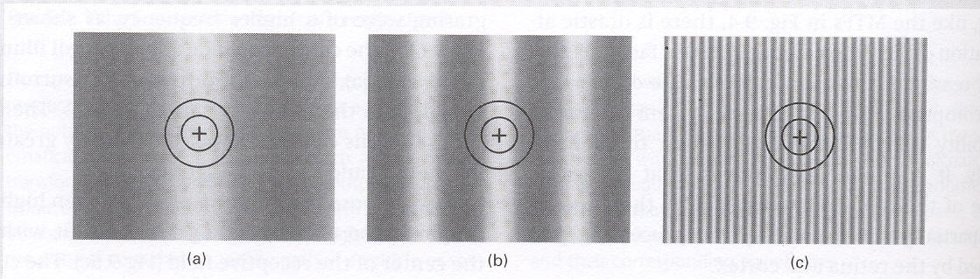
Visual neurons respond best when the size (SF) of the stimulus matches the size (SF) of the receptive field.
Stimulus “b” is the best match here.

Slide 36
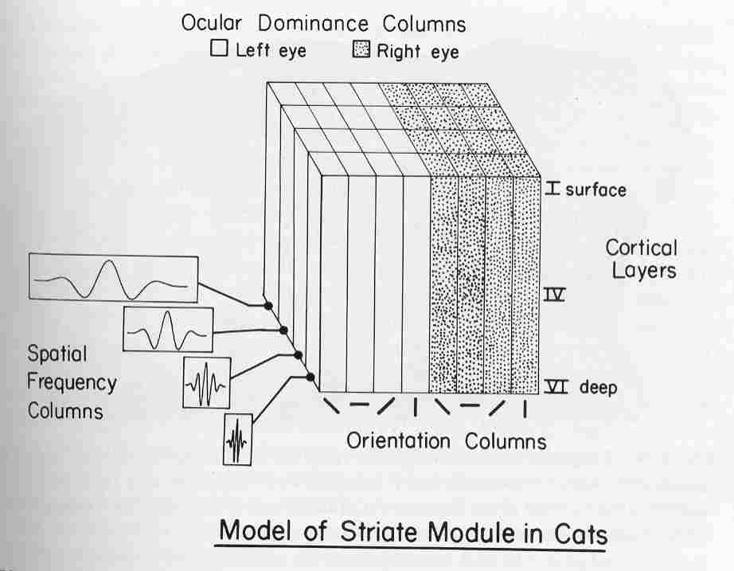
V1 Is Organized By Spatial Frequency

Slide 37
Part 1: Waves & Fourier Analysis
In principle, the visual system could respond in two ways to the retinal image.
One possibility is that the visual system responds to the Fourier components (i.e., a spatial-frequency analysis).
Another possibility is that the visual system responds to the point-by-point distribution of light.
Either way is a an acceptable PHYSICAL description of the stimulus. Let’s see an example of a point-by-point stimulus description….

Slide 38
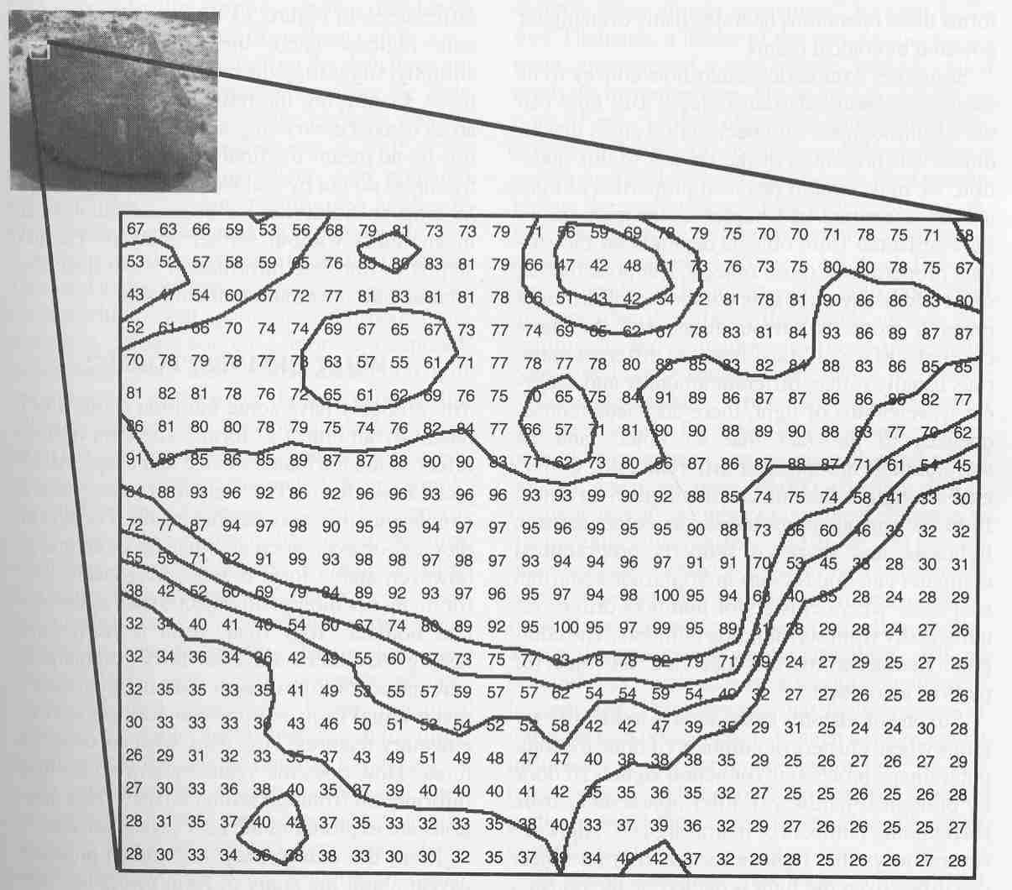
Point-By-Point Luminance Values

Slide 39
Sample Test Question
Write the point-by-point
luminance profile for these stimuli.

Slide 40
Sample Test Question
Potential Pop Quiz Question:
Write the point-by-point
luminance profile for these stimuli.

Slide 41
Sample Test Question
Potential Pop Quiz Question:
Write the point-by-point
luminance profile for these stimuli.

Slide 42
Sample Test Question
Potential Pop Quiz Question:
Write the point-by-point
luminance profile for these stimuli.

Slide 43
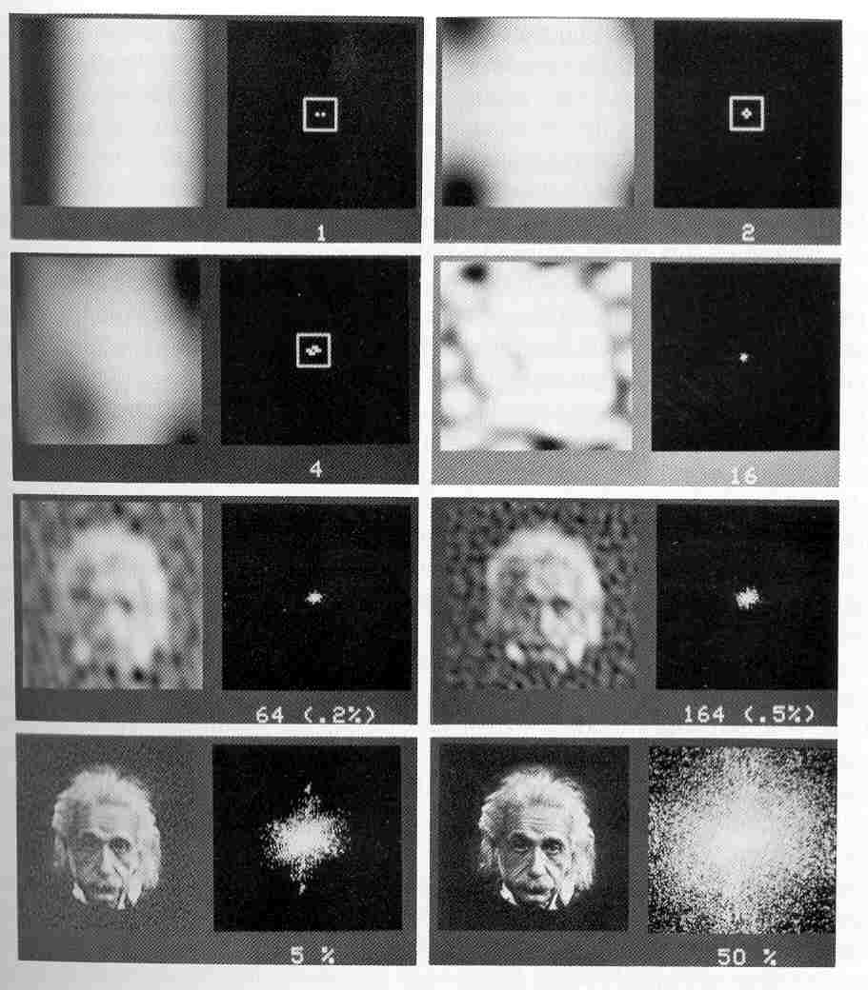
This Photo of Einstein Contained
65,500 Luminance Values, Point-By-Point.

Slide 44
The Same Photo Can Be Readily Identified
With Many Fewer Fourier (sine wave) Components.
A Fourier Analysis Would Be Neurally Economical.

Slide 45
Part 2
The Contrast Sensitivity Function
C.S.F.

Slide 46
Part 2: The CSF
The contrast sensitivity function
can be thought of
as a graph that indicates
how easily different SFs are seen.

Slide 47
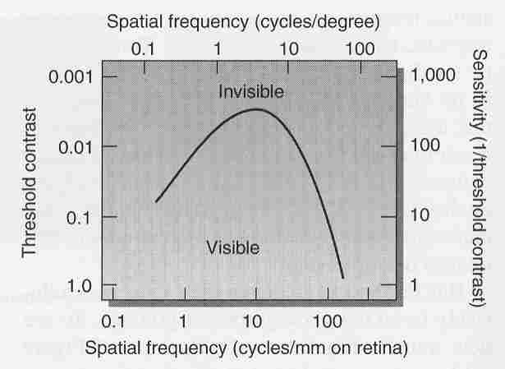
The Human Contrast Sensitivity Function

Slide 48
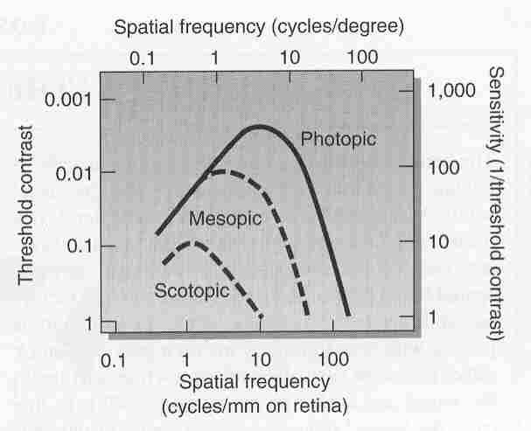
Human CSF: Day, Dusk, and Night

Slide 49
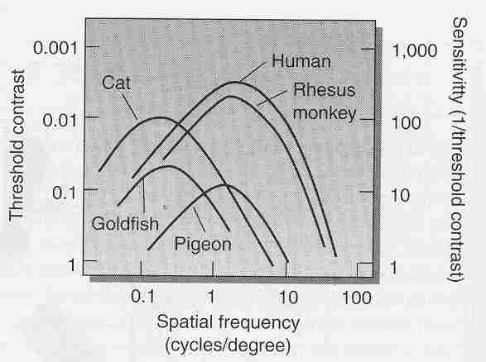
The CSF For Different Species

Slide 50
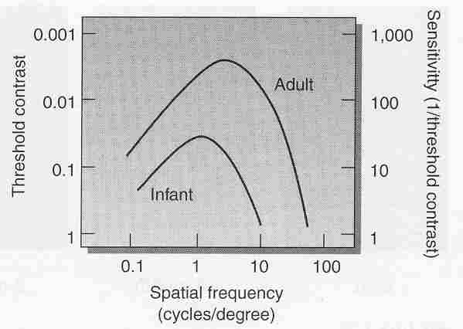
The Human CSF:
Infant (3 to 6 months) versus Adult

Slide 51
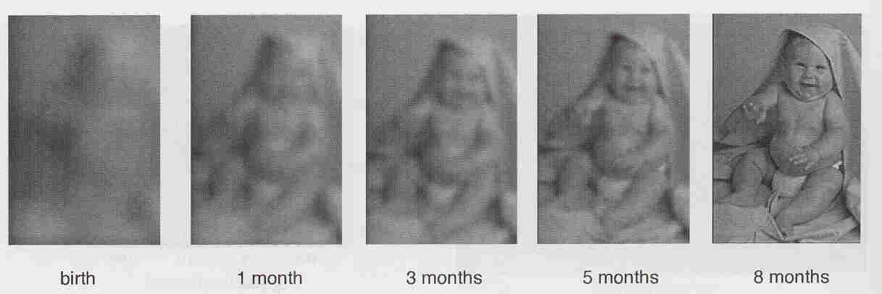
Potential Pop Quiz Question:
Draw Two CSFs, one for the
“1 month” condition below, and
One for the “8 months” condition below.
Label your axes. (No need for exact
Quantities, I’m just looking for the pattern.)

Slide 52
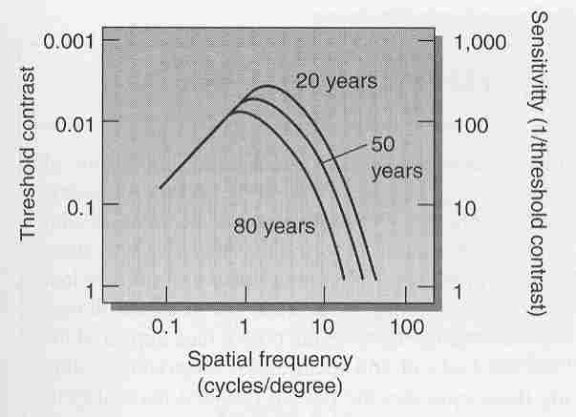
The Effect of Aging
on the Adult Human CSF

Slide 53
Part 3
Metamers

Slide 54
Part 3: Metamers
Metamers are physically different
stimuli that are
perceptually indistinguishable.

Slide 55
Part 3: Metamers
Metamers reveal a failure
in discrimination!

Slide 56
Part 3: Metamers
Because the human CSF differs
from the cat CSF,
stimuli that are “metameric”
for cats are not metameric
for humans (and vice versa).

Slide 57
Part 3: Metamers
As an example, the following photos
look different to you,
but would appear
indistinguishable to a cat.

Slide 58
Part 3: Metamers
Demo Here

Slide 59
Part 3: Metamers
Now, let’s change the
spatial frequency content.
Specifically, let’s increase
the SF of both stimuli until
the difference between them
falls outside our “window of visibility”,
making them metameric.

Slide 60
These Differ In Frequency
Low Spatial Frequency
Fat Bars:
Few Cycles Per Degree
C.P.D.
High Spatial Frequency
Thin Bars:
Many Cycles Per Degree
C.P.D.

Slide 61
Essentially, we just “moved” the Cat stimuli
from left to right in the frequency domain,
making differences invisible at the highest frequencies.

Slide 62
Part 3: Metamers
The artist Charles (Chuck) Close
takes advantage of the human
CSF in his art.
His art looks one way at one scale (SF),
and very different at a another scale (SF).

Slide 63
Demo Here

Slide 64
Part 4
Selective Adaptation
And
The Size Aftereffect

Slide 65
Selective Adaptation:
After adapting to a single SF,
contrast sensitivity is reduced
at or near that SF,
but NOT elsewhere.
This creates a “notch” in the CSF.

Slide 66
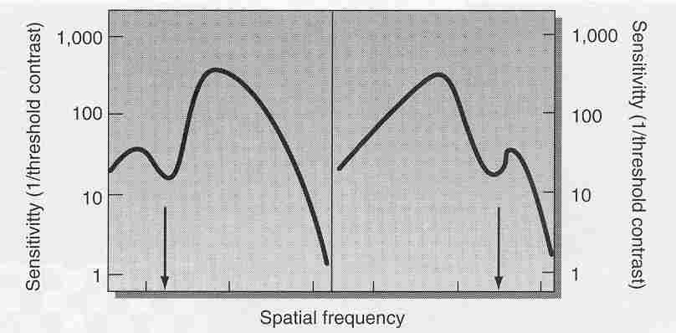
Selective Adaptation and the CSF

Slide 67
The Size Aftereffect:
The size aftereffect is conceptually
similar to the tilt aftereffect.
There is an illusion of size
(rather than orientation)
after adaptation to
a single spatial frequency.

Slide 68
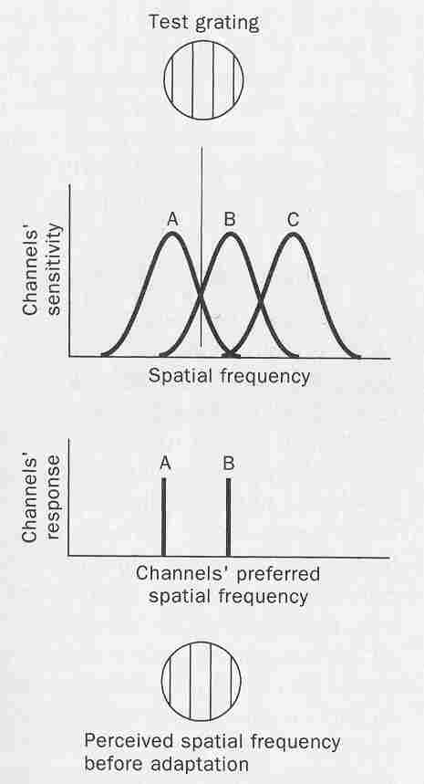
The Size Aftereffect: Pre-Adaptation

Slide 69
The Size Aftereffect:
Now, have the subject adapt
to a (low) spatial frequency
at or near “A”.

Slide 70
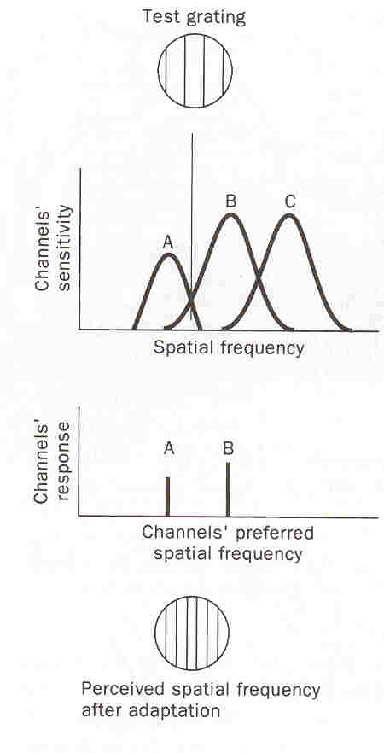
The Size Aftereffect: Post-Adaptation

Slide 71
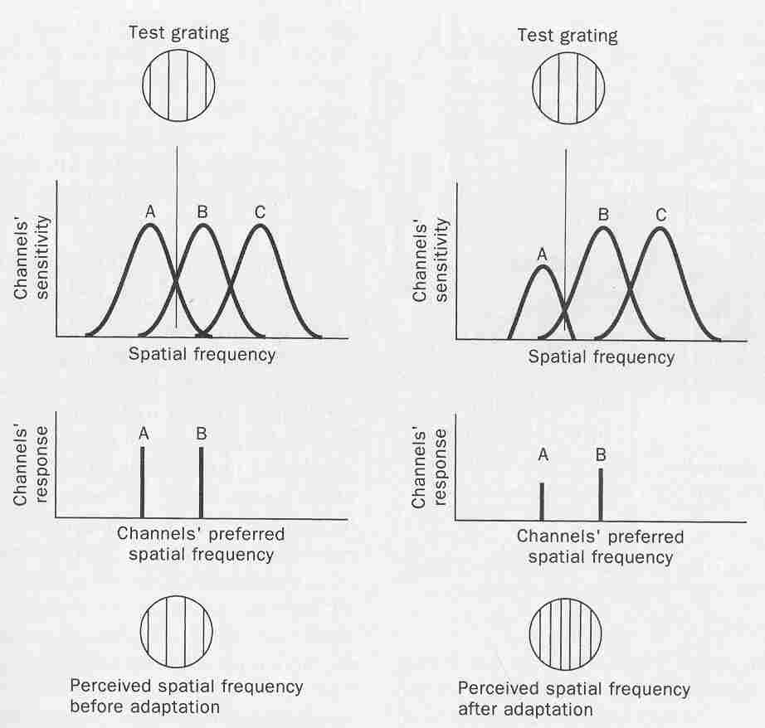
The Size Aftereffect:
Before & After Adaptation
Note
the
higher
frequency

Slide 72
The Size Aftereffect:
Like the tilt aftereffect (an illusion of orientation),
the size aftereffect arises from
and adaptation-induced bias
in the POPULATION’S response.

Slide 73
So, you can “fatigue” an orientation column, or a spatial frequency column!

